Slide 1
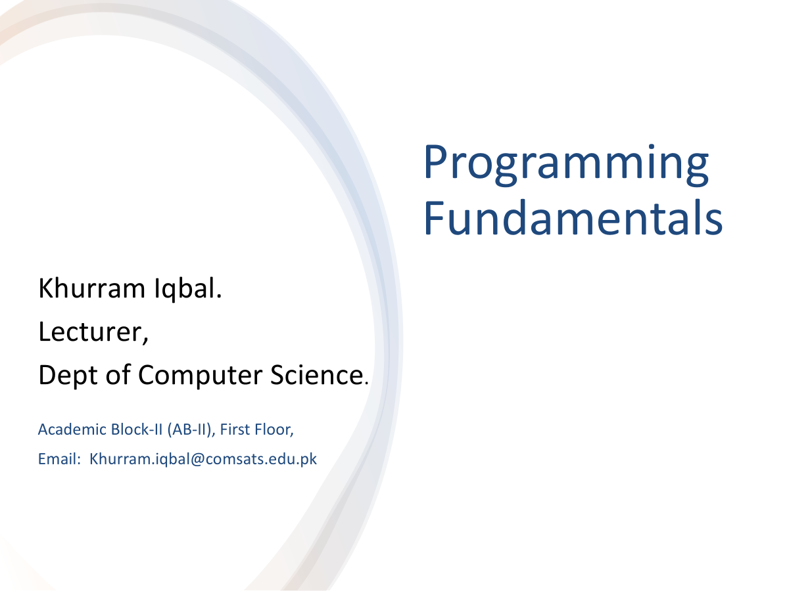

Slide 2

Lecture Outline
Programming Language
A Simple Java Program
Creating, Compiling, and Running Programs
Anatomy of a Java Program
Programming Style and Documentation
Programming Errors

Slide 3

Programming Language
Computer Program
Sequence of statements intended to accomplish a task
Programming
A process of planning and creating a program
Programming language
A set of rules, symbols, and special words used to construct programs
Syntax rules
Which statements (instructions) are legal, or accepted by the programming language, and which are not
Semantic rules
Determine the meaning of the instructions

Slide 4
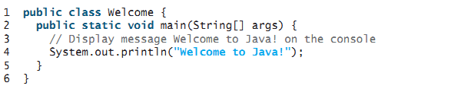
A Simple Java Program
Save this file as Welcome.java
To compile: | javac Welcome.java
To execute: | java Welcome

Slide 5
Components of a Java Program
Class name
Main method
Statements
Statement terminator
Reserved words
Comments
Blocks

Slide 6
Class Name
Java program must have at least one class
Class name and file name must be same(Welcome.java)
In Java all code must reside inside the class
Java is case-sensitive
In this example, the class name is Welcome
// This program prints Welcome to Java!
public class Welcome {
public static void main(String[] args) {
System.out.println("Welcome to Java!");
}
}

Slide 7
Main Method
Java program begins execution by calling main()
Main is different from main. (case sensitive)
// This program prints Welcome to Java!
public class Welcome {
public static void main(String[] args) {
System.out.println("Welcome to Java!");
}
}

Slide 8
Statement
A statement represents an action or a sequence of actions.
The statement displaying Welcome to Java! on console
System.out.println("Welcome to Java!")
// This program prints Welcome to Java!
public class Welcome {
public static void main(String[] args) {
System.out.println("Welcome to Java!");
}
}

Slide 9
Statement Terminator
Every statement in Java ends with a semicolon (;).
// This program prints Welcome to Java!
public class Welcome {
public static void main(String[] args) {
System.out.println("Welcome to Java!");
}
}

Slide 10
Blocks
A pair of braces in a program forms a block that groups components of a program.

Slide 11
Java Tokens
Token
The smallest individual unit of a program in any programming language
Java tokens are divided into
Special Symbols
Word Symbols (Reserve/keywords)
Identifiers

Slide 12
Special Symbols

Slide 13
Word Symbols
Reserved words or keywords
Specific meaning to the compiler and
Cannot be used for other purposes in the program.
// This program prints Welcome to Java!
public class Welcome {
public static void main(String[] args) {
System.out.println("Welcome to Java!");
}
}

Slide 14
Identifiers
Identifiers are the names that identify the elements such as classes, methods, and variables in a program.
An identifier is a sequence of characters that consist of letters, digits, underscores (_), and dollar signs ($).
An identifier must start with a letter, an underscore (_), or a dollar sign ($). It cannot start with a digit.
An identifier cannot be a reserved word. (53 keywords are reserved for use by the Java language)
An identifier cannot be true, false, or null.
An identifier can be of any length.

Slide 15
Identifiers
Java is case sensitive, area, Area, and AREA are all different identifiers.
Legal Identifers
$2, ComputeArea, area, radius, and print
Illegal Identifers:
2A, d+4
Which of the following identifiers are valid? Which are Java keywords?
miles, Test, a++, ––a, 4#R, $4, #44, apps, class, public, int, x, y, radius

Slide 16
Programming Style and Documentation
Appropriate Comments
Naming Conventions
Proper Indentation and Spacing Lines
Block Styles

Slide 17

Appropriate Comments
Include a summary at the beginning of the program to explain what the program does, its key features, its supporting data structures, and any unique techniques it uses.
Include your name, class section, instructor, date, and a brief description of program at the beginning of the program.

Slide 18

Naming Conventions
Choose meaningful and descriptive names.
Variables and method names:
Use lowercase
If the name consists of several words, concatenate all in one, use lowercase for the first word, and capitalize the first letter of each subsequent word in the name
For example, the variables radius and area, and the method computeArea.

Slide 19
Naming Conventions
Class names:
Capitalize the first letter of each word in the name.
For example, the class name ComputeArea.
Constants:
Capitalize all letters in constants and use underscores to connect words.
For example, the constant PI and MAX_VALUE

Slide 20
Proper Indentation and Spacing
Indentation
Indent at least two spaces.
Spacing
Use blank line to separate segments of the code.
public static void main(String args[]){ System.out.println("Welcome to JAVA");
}
System.out.println(3+4*4); Bad style
System.out.println(3 + 4 * 4); Good style

Slide 21
Block Styles
A block is a group of statements surrounded by braces. There are two popular styles, next-line style and end-of-line style

Slide 22
Syntax Errors
Detected by the compiler
Runtime Errors
Causes the program to abort
System.out.println(1 / 0);
Logic Errors
Produces incorrect result
Programming Errors

Slide 23
Common errors
Common Error 1: Missing Braces
Common Error 2: Missing Semicolons
Common Error 3: Missing Quotation Marks
Common Error 4: Misspelling Names(e.g. Main)

Slide 24
Activity
Identify and fix the errors in the following code:
public class Welcome {
public void Main(String[] args) {
System.out.println('Welcome to Java!);
}

Slide 25

Activity
Write a program that displays Welcome to Java five times.
Write a program that displays the following pattern

Slide 26

Write a program that produces the following output:

Slide 27
Basic Steps of Programming in Java
1. Variable Declaration
Defining a variable’s type and name.
Example: int num;
2. Variable Initialization
Assigning an initial value.
Example: int num = 10;
3. Input
Taking user input using Scanner.
Example: Scanner sc = new Scanner(System.in);
int num = sc.nextInt();
4. Processing
Performing operations on data.
Example: int sum = num1 + num2;
5. Output
Displaying results using System.out.println.
Example: System.out.println("Sum: " + sum);

Slide 28
Java Program Demonstrating Basic Steps
import java.util.Scanner;
public class CircleAreaCalculator {
public static void main(String[] args) {
// 1. Variable Declaration
double radius, area;
final double PI = 3.14159; // Constant value for π
// 2. Input
Scanner sc = new Scanner(System.in);
System.out.print("Enter the radius of the circle: ");
radius = sc.nextDouble(); // Taking user input
// 3. Processing
area = PI * radius * radius; // Calculating the area
// 4. Output
System.out.println("The area of the circle is: " + area);
sc.close(); // Closing the scanner
}
}

Slide 29
Summary
Features of Java
Parts of a simple Java Program
How to write, compile and run a Java Program
Program Documentation
Program Errors

